Slide 1
SustainAI - Automated Recycling Classification
Shizza Asher 20L-1184
Haleema Jamil 20L-1210
Amin Ahmed 20L-2164

Slide 2
Table of Contents
01
02
03
04
05
06
Problem Statement
Dataset Information
Data Distribution & Visualisation
Preprocessing & Transformation
Model & Results
Mobile Application

Slide 3
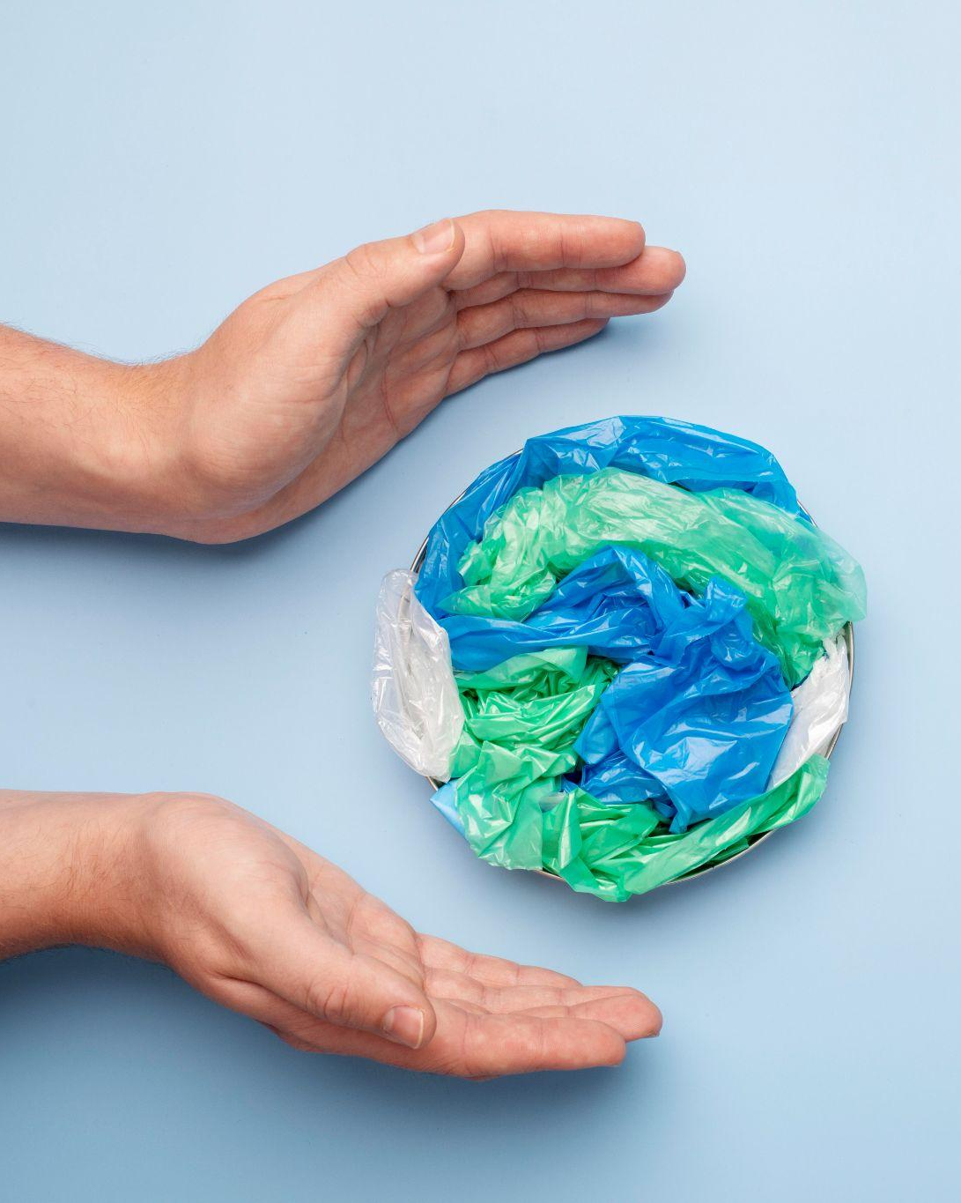
01
Problem Statement

Slide 4
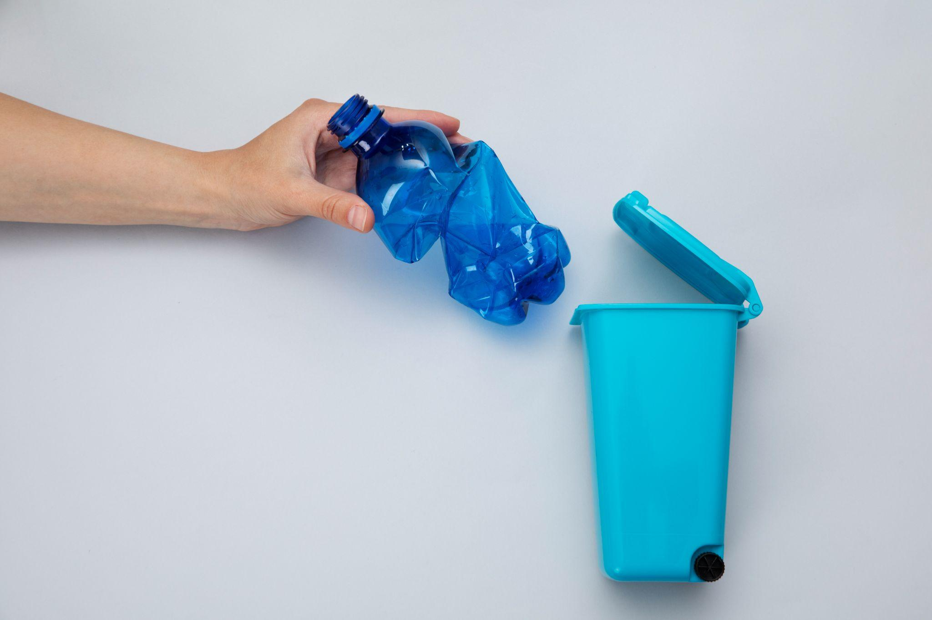
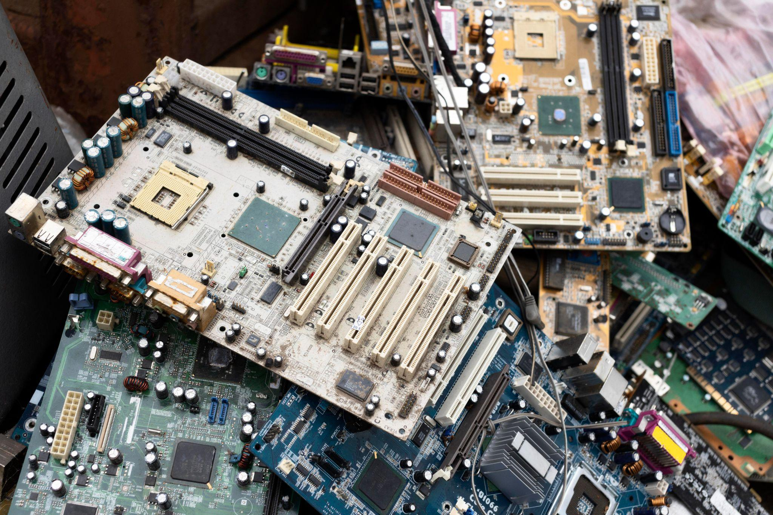
Automated Waste Sorting
Reduce reliance on manual labor in waste sorting.
Promote sustainable waste management practices.
Enhances recycling efficiency, leading to reduced environmental impact.
Decreases contamination in recycling streams, improving overall recycling rates.

Slide 5
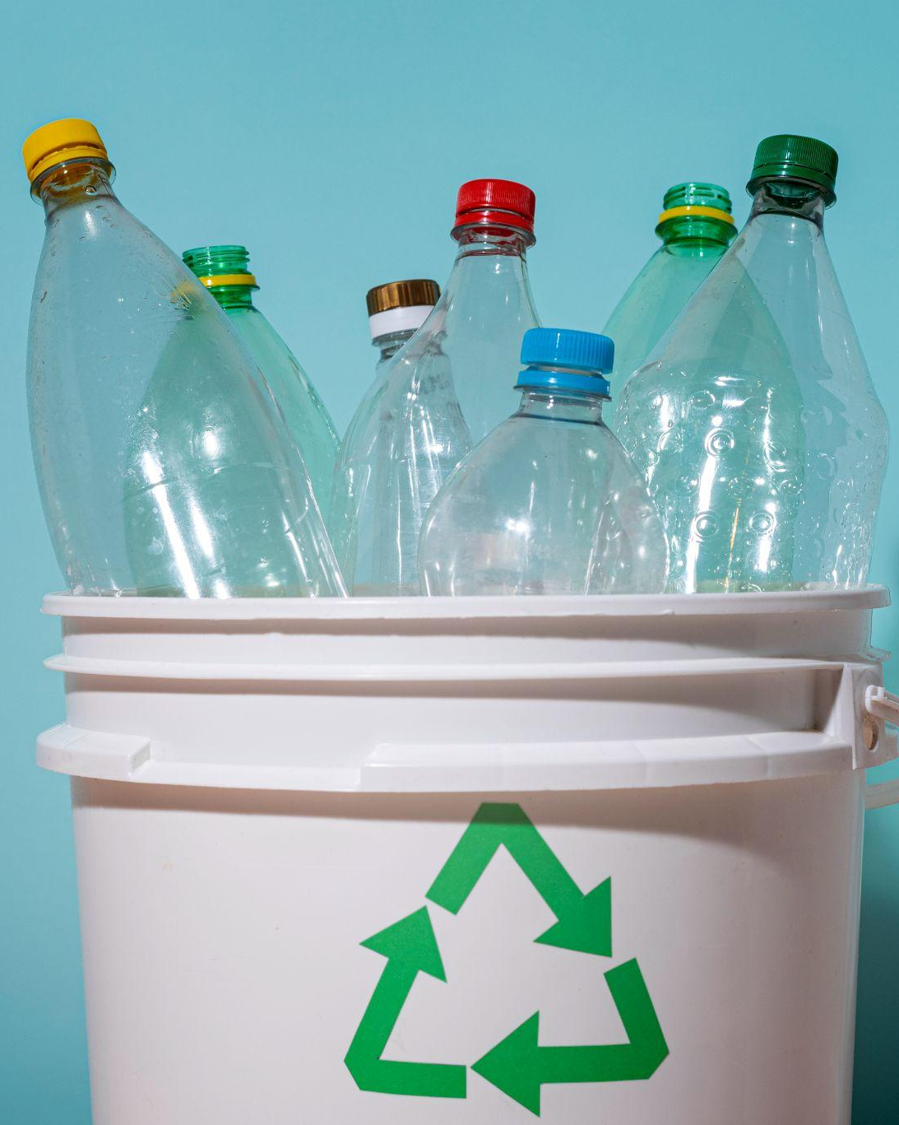
What is SustainAI?
Utilizes an efficient CNN for waste classification.
Capable of identifying various materials such as plastic, paper, and metal, leaf and wood.
Designed for integration into existing waste management facilities.
Potential for widespread adoption in various regions and industries.

Slide 6

02
Dataset Information

Slide 7
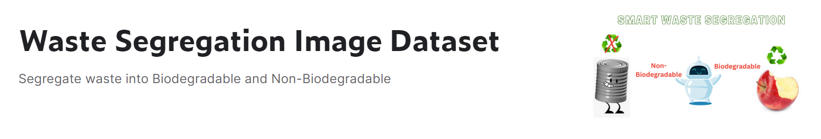
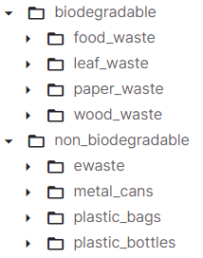
Data Source
Dataset obtained from kaggle
Two directories -> Biodegradable & Non-Biodegradable
Plastic bags and plastic bottles merged -> Plastic
https://www.kaggle.com/datasets/aashidutt3/waste-segregation-image-dataset/data

Slide 8
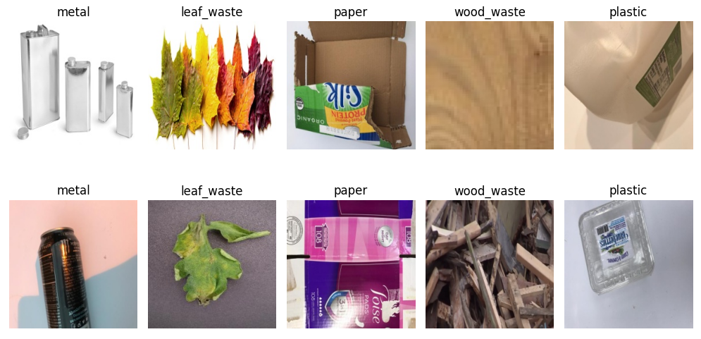
Sample Images

Slide 9
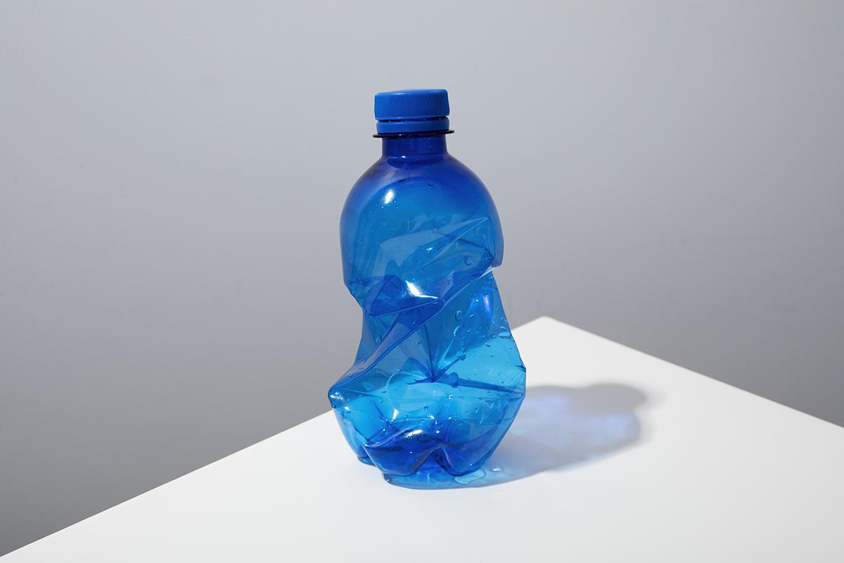
03
Data Distribution & Visualization

Slide 10
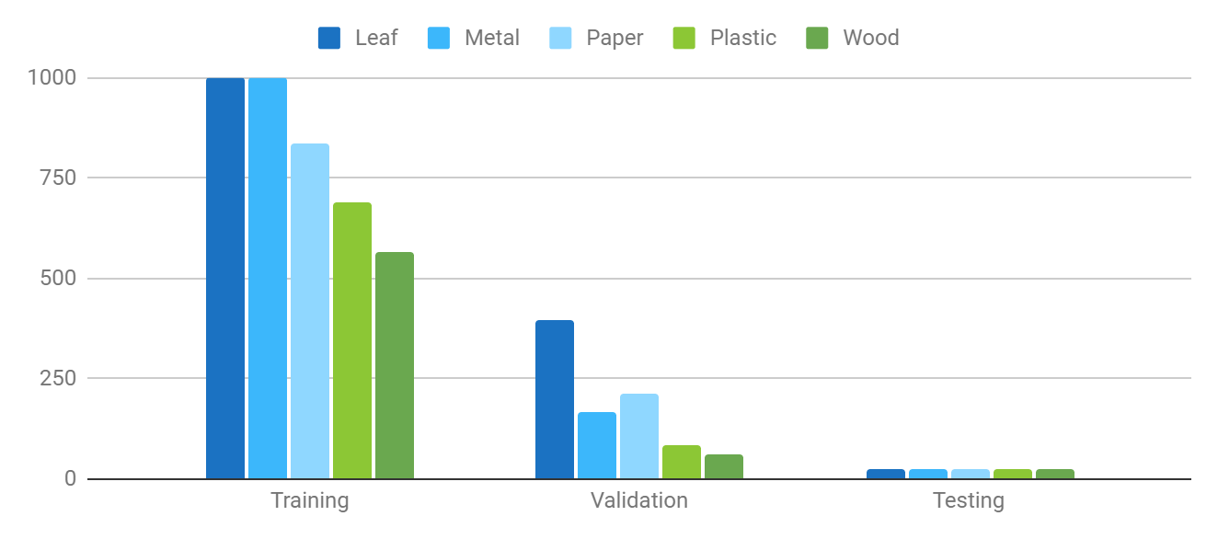
Original Data Distribution
Notes:
Total Images in Original = 5137

Slide 11
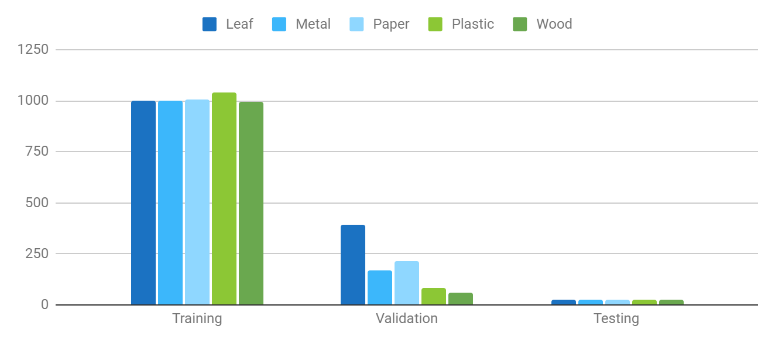
Preprocessed Data Distribution
Notes:
Total Images in Preprocessed = 6079

Slide 12
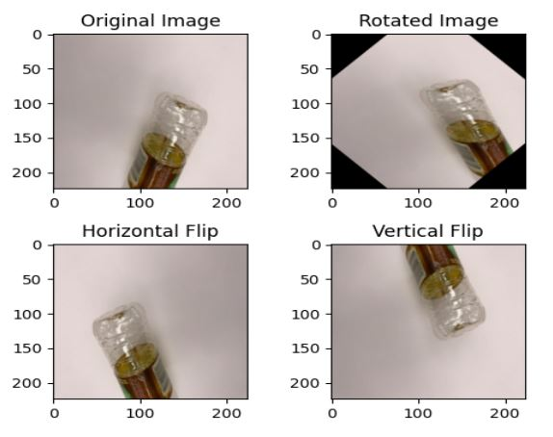
Augmentations
45 Degree Rotation
Horizontal Flip
Vertical Flip

Slide 13

04
Preprocessing & Transformation

Slide 14
Preprocessing
Color format conversion from BGR to RBG.
Resizing images to 224 by 224.
Conversion to numpy arrays and to float.
Normalizing all pixel values by dividing by 255.
Reshaping to
(224, 224, 3).
One hot encoding done for multiclass classification.

Slide 15
05
Model & Results

Slide 16
Model Pipeline
Data Loaders
Learning Rate
Transfer Learning
Preparing image datasets using TensorFlow data pipeline tools.
Used an exponential LR schedule function for fine-tuning the CNN.
The Xception model is used as the feature extractor.
Hyperparameters
Activation Function
Model Head
ADAM optimizer and CCE loss. 15 epochs.
ReLU and softmax are used on hidden and output layers.
Additional layers: pooling, dropout, batch normalization, and dense layers.

Slide 17
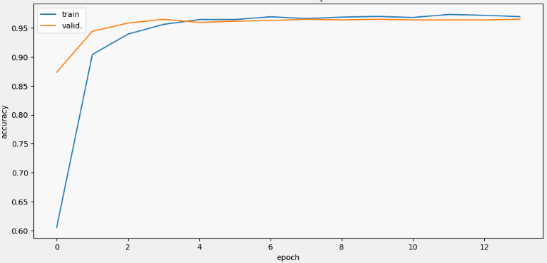
Model Accuracy

Slide 18
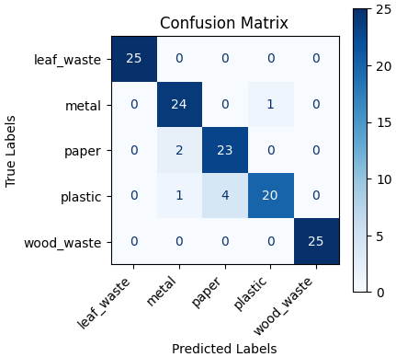
Evaluation Metrics
Accuracy = 0.94
F1-score - 0.94
Precision = 0.94
Recall = 0.94
Classification Report:
precision recall f1-score support
0 1.00 1.00 1.00 25
1 0.89 0.96 0.92 25
2 0.85 0.92 0.88 25
3 0.95 0.80 0.87 25
4 1.00 1.00 1.00 25
accuracy 0.94 125
macro avg 0.94 0.94 0.94 125
weighted avg 0.94 0.94 0.94 125

Slide 19
06
Mobile Application

Slide 20
Steps
Input
Preprocess
Pass to Model
Compute Output
Display Output
From camera or gallery
Resize to 224x224
Normalize in range 0-255
Get a vector of probabilities
Index with maximum probability
Display label at that index

Slide 21
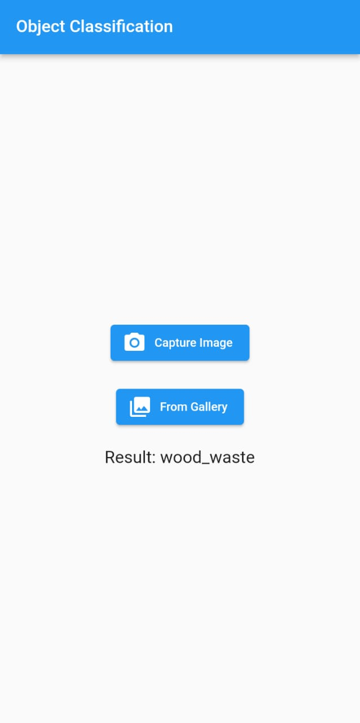
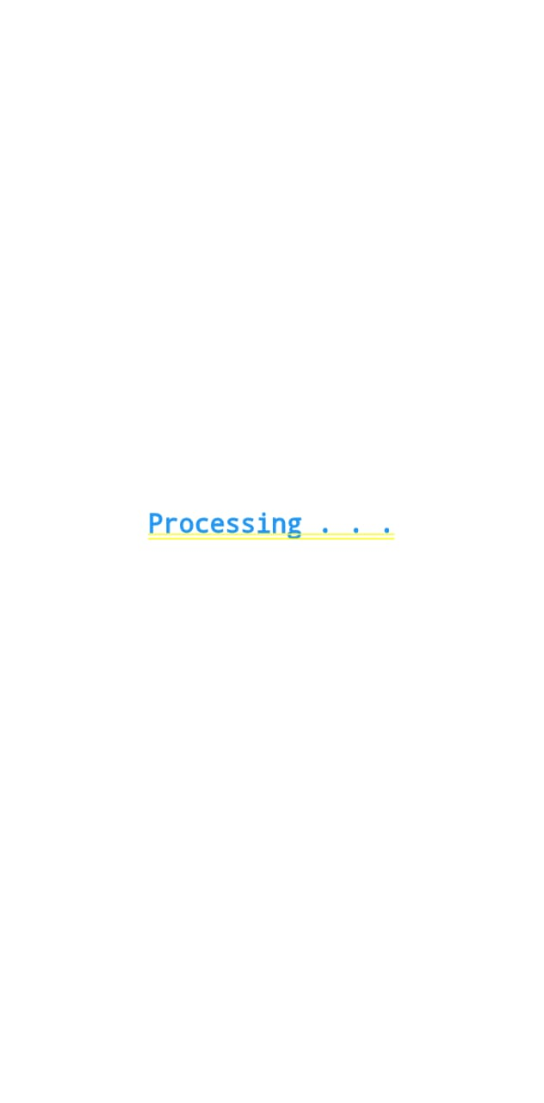
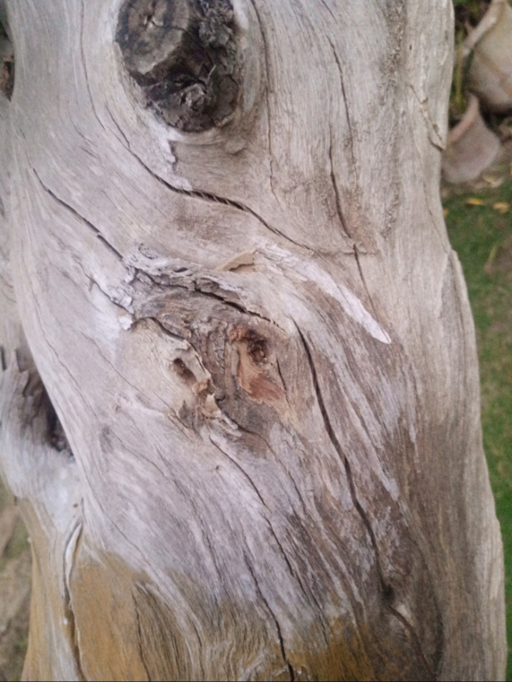
Examples

Slide 22
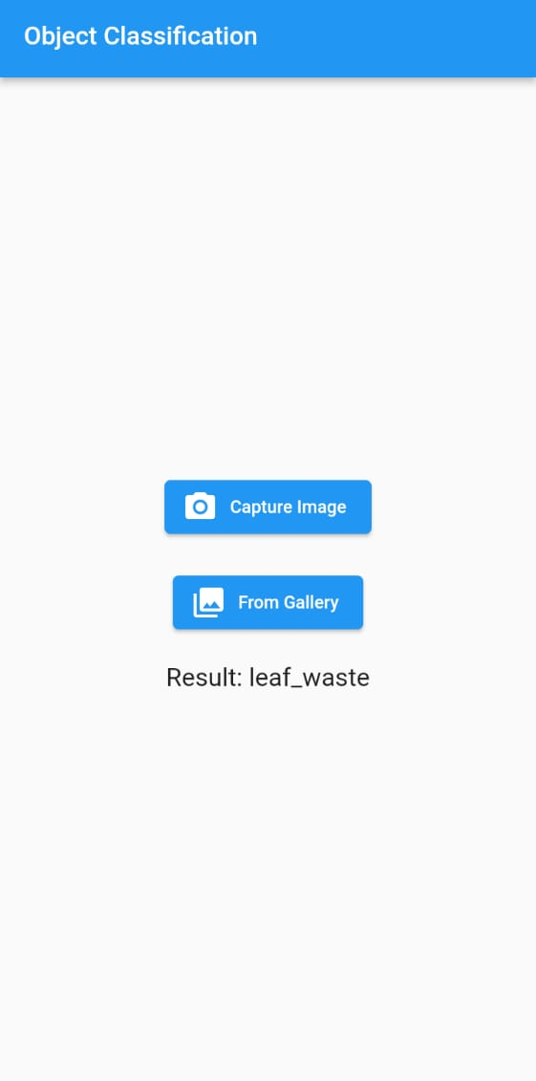
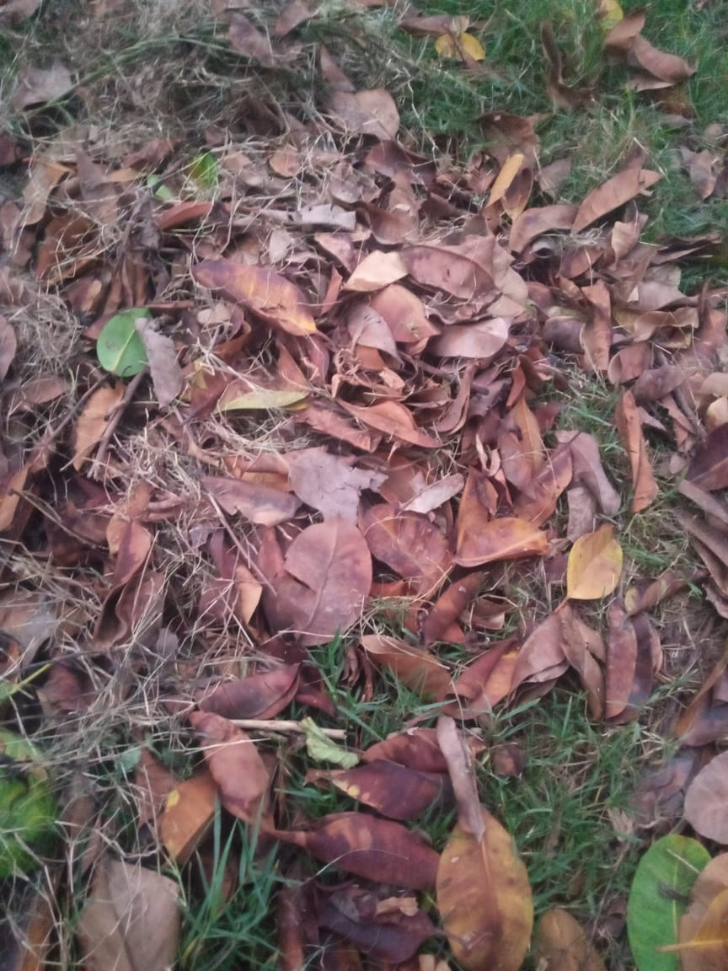
Examples

Slide 23
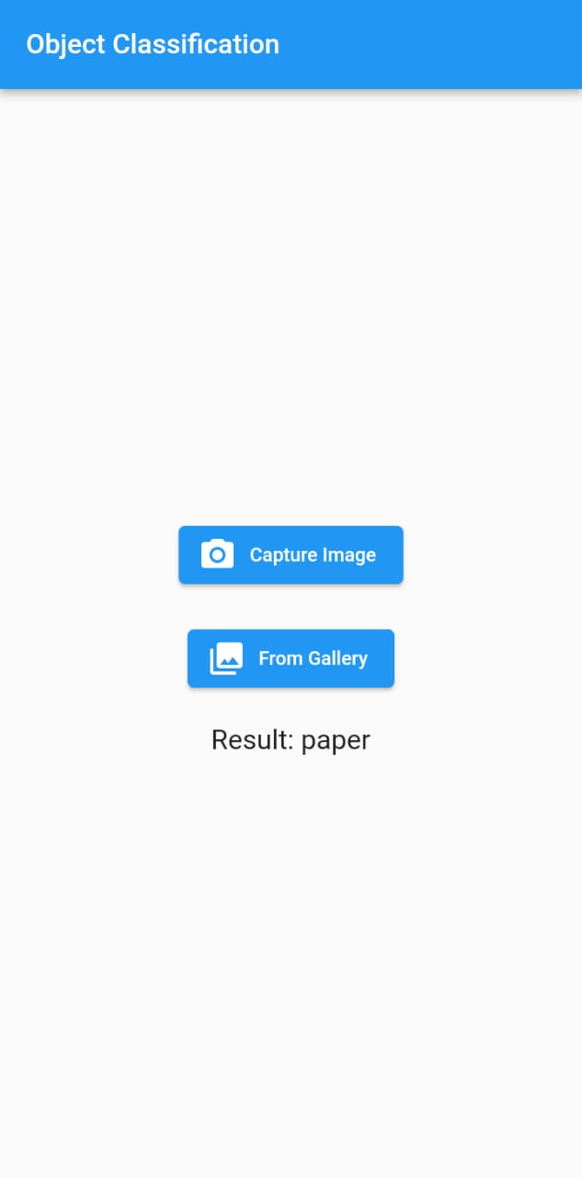
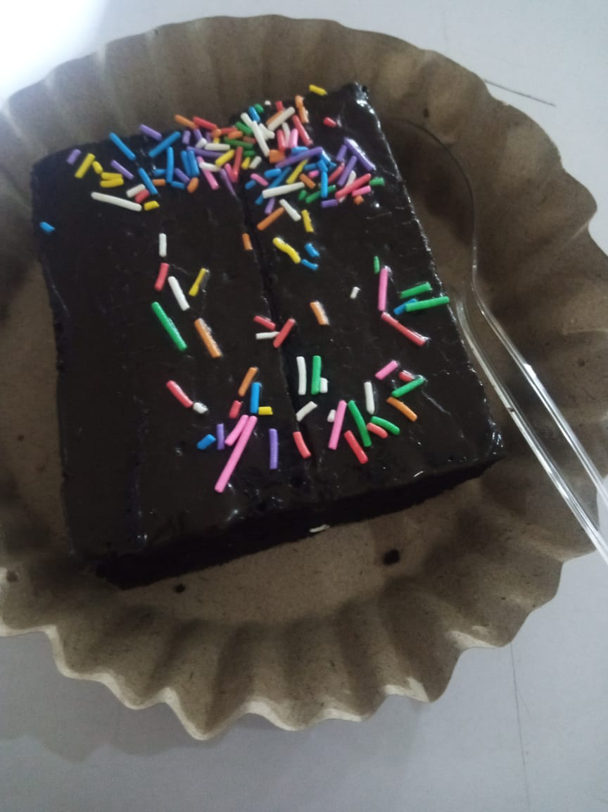
Examples

Slide 24

Thanks!
Do you have any questions?

